Slide 1
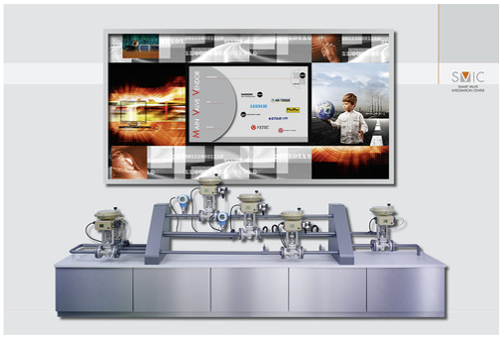
Configuration Tools
Product Management and Marketing • Positioners and Valve Accessories
July 2014
2014-07/V31 · Configuration Tools · 1

Slide 2
Agenda
Why Configuration Tools?
User Interfaces
Local Configuration Possibilities
  On-site Configuration
  TROVIS-VIEW
  Definition DTM/FDT
  Stand alone Applications
  Handhelds
  Overview Positioners and Relevant Hard- and Software
Configuration Tools for Communication Protocols
2014-07/V31 · Configuration Tools · 2

Slide 3
Why Configuration Tools?
Parameter adjustment
Utilization of diagnostics
Configuration
tools
enable
…
Start of initialization
Read out of device data
Configuration Tools are the interface between positioner and user
Different configuration tools can be used, depending on the technical equipment of the customer and the device
2014-07/V31 · Configuration Tools · 3

Slide 4
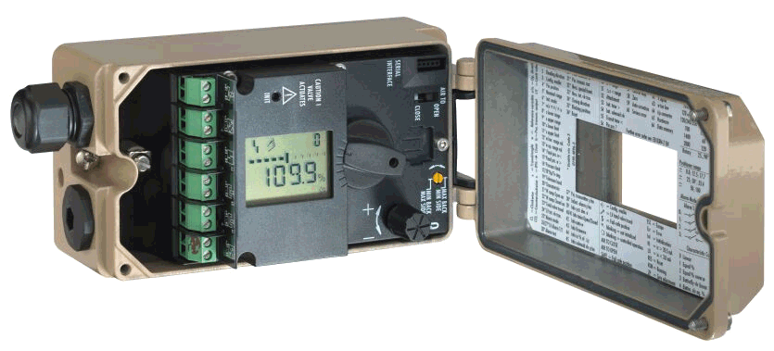
Overview – Access Interfaces
On-site configuration
SSP port
HART / Foundation Fieldbus / Profibus
Interface adapter cable & PC
DD / EDD / DTM
- Handheld or PC
- Cable / Modem
DCS
TROVIS-VIEW
Stand alone frame application
(e.g. FDT…)
Engineering tools (e.g. AMS,PRM…)
Local configuration
2014-07/V31 · Configuration Tools · 4

Slide 5
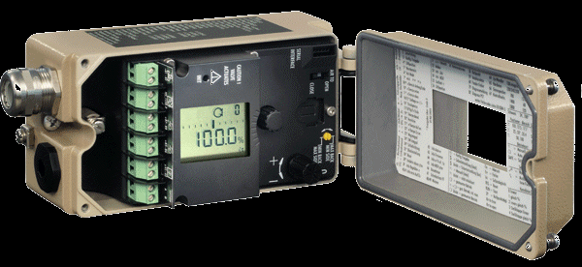
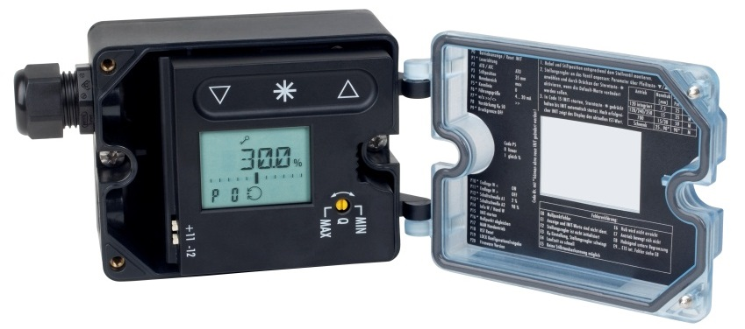

Local Configuration – On-site Configuration
Standard operation of digital positioners directly at the device to navigate through the menu and to adjust the parameter codes
Turn/push button for 3730 series
Capacitive keys for type 3725
2014-07/V31 · Configuration Tools · 5

Slide 6
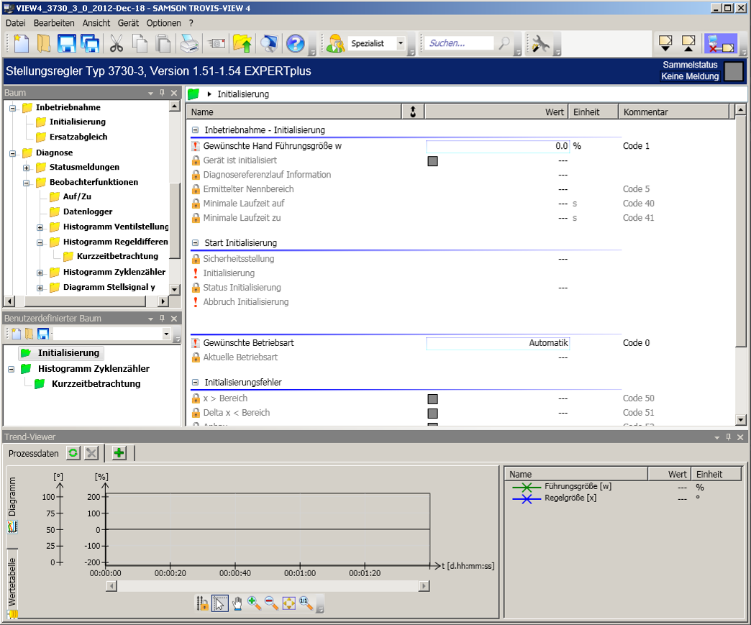
Local Configuration – TROVIS-VIEW
More complex visualization possible
Standardized operating interface for more than 25 different SAMSON devices
2014-07/V31 · Configuration Tools · 6

Slide 7
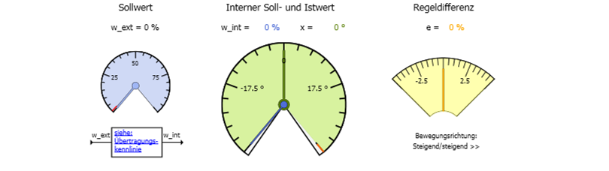
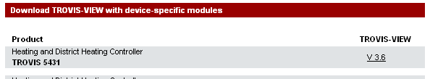
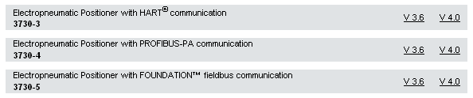
Local Configuration – TROVIS-VIEW
Graphics (histograms, trends, …)
TROVIS-VIEW on the Internet – information / download / driver software
http://www.samson.de/page.php?sp=de&lh=l4&ll=l99&ti=TROVIS-VIEW&bo=service/de-trovis-view.php
2014-07/V31 · Configuration Tools · 7

Slide 8
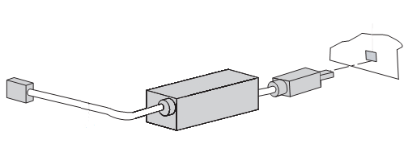
Local Configuration – TROVIS-VIEW
Connection to PC via SSP interface
  Isolated USB Interface Adapter necessary
TROVIS-VIEW 4 is interoperable with:
  Windows® XP
  Windows® Vista
  Windows® 7
Versions ≥ 3.60 are free
2014-07/V31 · Configuration Tools · 8

Slide 9

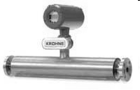


Configuration Tools for Communication Protocols
Communication Protocols
Fieldbuses
  Connect field devices to DCS
HART
  Uses input signal 4 – 20 mA
FOUNDATION
FIELDBUS
PROFIBUS-PA
HART
2014-07/V31 · Configuration Tools · 9

Slide 10
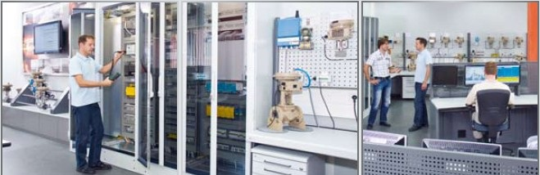

Integration Software for Field Devices
Software „driver“ for field device description in specific description languages,
summarize the performance characteristics of the field devices and serve as drivers for the device integration
DD – Device Description
eEDD – enhanced Electronic Device Description / Enhancements enable visualization of graphics, histograms, trends …
GSD – Device data base file / PROFIBUS
DTM – Device Type Manager / Includes an own operation tool
2014-07/V31 · Configuration Tools · 10

Slide 11
What is FDT/DTM ?
FDT – Field Device Tool
Standardized (software) interface; specifies the data transmission between the system level (FDT frame application) and the field devices (e.g. positioners)
DTM – Device Type Manager
Every field device (e. g. positioner) has its own – manufacturer specific – driver including a configuration tool, comparable to a printer. This driver is called Device Type Manager (DTM) and contains all data and functions of the field device.
SAMSON DTM can be downloaded:
http://www.samson.de/page.php?sp=de&lh=l4&ll=l99&ti=Integration%20in%20Engineering%20Tools%20und%20Systeme&bo=service/de-dtm.php
SAMSON device DTM enable as device drivers the integration in FDT-based frame applications such as:
  Engineering tools via DCS
  FDT-based „stand-alone“ configuration software, e.g. PACTware or Fieldcare
2014-07/V31 · Configuration Tools · 11

Slide 12


Local Configuration Possibilities – FDT/DTM as „Stand-Alone Application“
Connection to the 4 – 20 mA signal outside of an explosion protected area
„Stand-alone“ FDT frame applications such as PACTware or
Fieldcare enable the use of the SAMSON positioner DTM for the local configuration
PACTware is a manufacturer-, fieldbus- and device-independent FDT frame application to process DTM via a computer
HART positioner (373x-3 & 3730-6)
    HART modem with USB interface
    Positioner DTM
    Modem driver
Fieldbus positioners (3730-4 & 373x-5) need a high-priced Fieldbus card
2014-07/V31 · Configuration Tools · 12

Slide 13
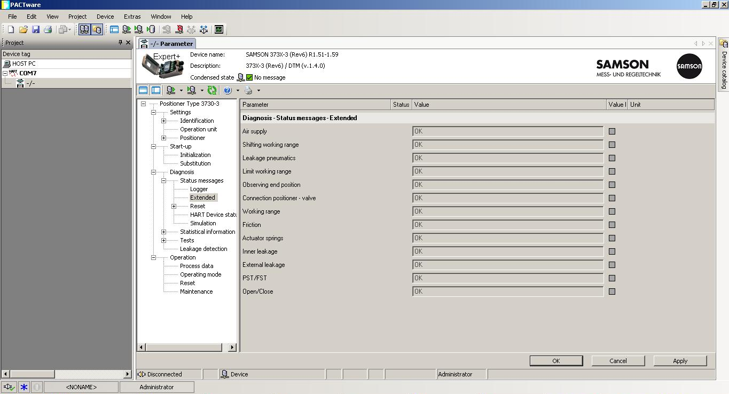
SAMSON Positioner DTM
2014-07/V31 · Configuration Tools · 13
Notes:
13

Slide 14
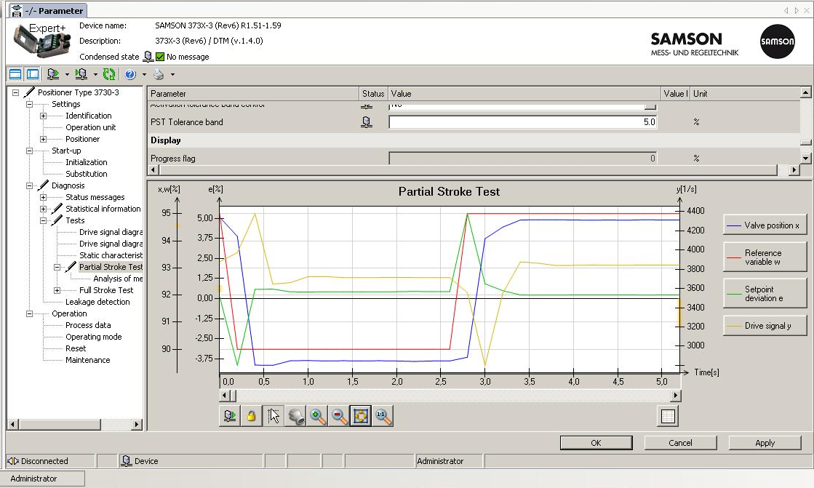
SAMSON Positioner DTM
2014-07/V31 · Configuration Tools · 14
Notes:
14

Slide 15
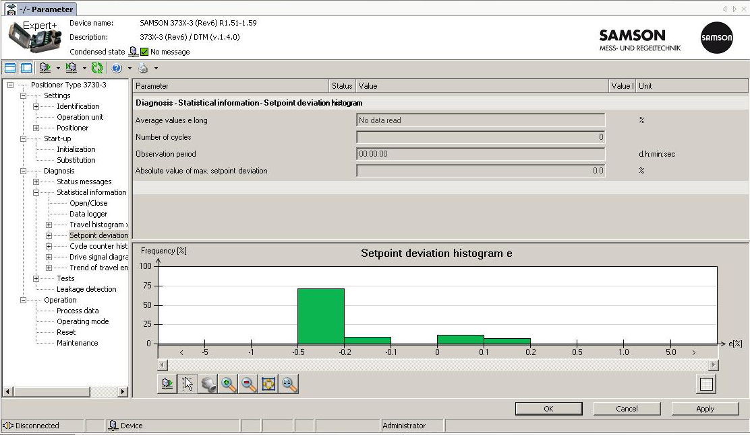
SAMSON Positioner DTM
2014-07/V31 · Configuration Tools · 15
Notes:
15

Slide 16

DTM & TROVIS-VIEW
DTM
TROVIS-VIEW
2014-07/V31 · Configuration Tools · 16

Slide 17
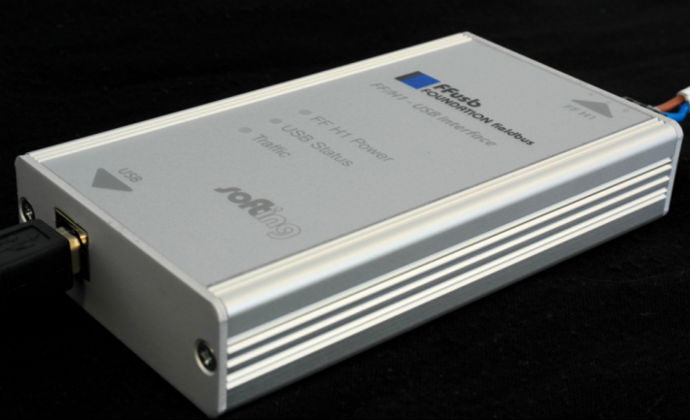
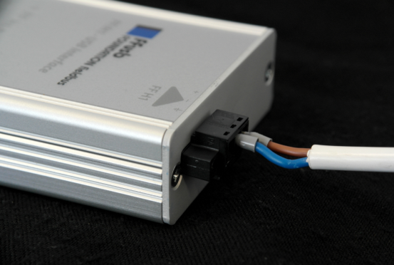
Local Configuration Possibilities – Stand-Alone Solutions for Fieldbus Applications
Local Stand-alone solutions also for fieldbus available
Special fieldbus cards are necessary
Very expensive solution (several thousand Euro) because of the fieldbus cards
Only few applications
2014-07/V31 · Configuration Tools · 17

Slide 18
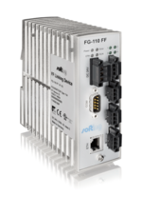
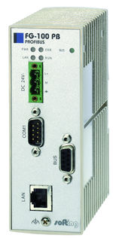
Local Configuration Possibilities – Solutions for Fieldbus Applications
Gateways with connection via TCP/IP
Communication parallel to DCS
Required software and hardware:
  Gateway
  Computer with FDT frame application (e. g. PACTware)
  DTM
  Ethernet network or crossover cable (between computer and gateway)
Gateways:
  FG PROFIBUS by Softing for PROFIBUS
  FG-110 FF by Softing for FOUNDATION Fieldbus
FG-110 FF (Softing)
FG PROFIBUS (Softing)
2014-07/V31 · Configuration Tools · 18

Slide 19

Local Configuration Possibilities – Handhelds
Emerson Field Communicator 375/475
  Read-out of device data
  Configuration of the field device
  For HART and FOUNDATION FIELDBUS
Connection
  Direct connection to field device
  Parallel connection to computer possible, for more comfortable configuration and for the use of a bigger display
  Hardware included in delivery
Handhelds by E+H
  Field Xpert SFX100
  With HART-Bluetooth-modem for the connection
2014-07/V31 · Configuration Tools · 19

Slide 20
Overview – Local Configuration Tools for Different Positioners
 | TROVIS-VIEW | FDT/DTM* | Handhelds | Stand-alone solutions for fieldbuses
3730-0 | - | - | - | -
3730-1 | - | - | - | -
3730-2 | X | - | - | -
373x-3 | X | X | X | -
3730-4 | X | X | - | X
373x-5 | X | X | X | X
3730-6 | X | X | X | -
* Also as device driver for FDT-based engineering tools via DCS
2014-07/V31 · Configuration Tools · 20

Slide 21
Overview – Required Hardware and Software for Local Configuration Tools
 | TROVIS-VIEW | FDT/DTM* | Handhelds | Stand-alone solutions for fieldbuses
Software required | TROVIS-VIEW + driver for Isolated USB Interface Adapter | PACTware or FieldCare, positioner DTM, communication DTM (driver) | (E)DD, manufacturers‘ software, if connection to PC required | NI fieldbus configurator (for FF) or PACTware (for devices with DTM)
Hardware required | Isolated USB Interface Adapter | HART modem with USB access (e.g. VIATOR USB HART IF by MACTeK Corporation) | Handheld and manufacturer specific hardware | Fieldbus card
* Also as device driver for FDT-based engineering tools via DCS
2014-07/V31 · Configuration Tools · 21

Slide 22




Configuration Tools for Communication Protocols
 | Emerson Delta V/ AMS | Yokogawa Centum/ PRM | Siemens PDM / only DD | Honeywell Experion
HART 373x-3/-6 | X | X | X | X
Foundation Fieldbus 373x-5 | X | X | X | X
Profibus 3730-4 |  |  | X
Status: January 2013 // ABB 800XA (FF + Profibus / only DTM)
Suitable device integration software (DD, DTM…) as well as further integration:
http://www.samson.de/page.php?sp=de&lh=l4&ll=l2
2014-07/V31 · Configuration Tools · 22

Slide 23
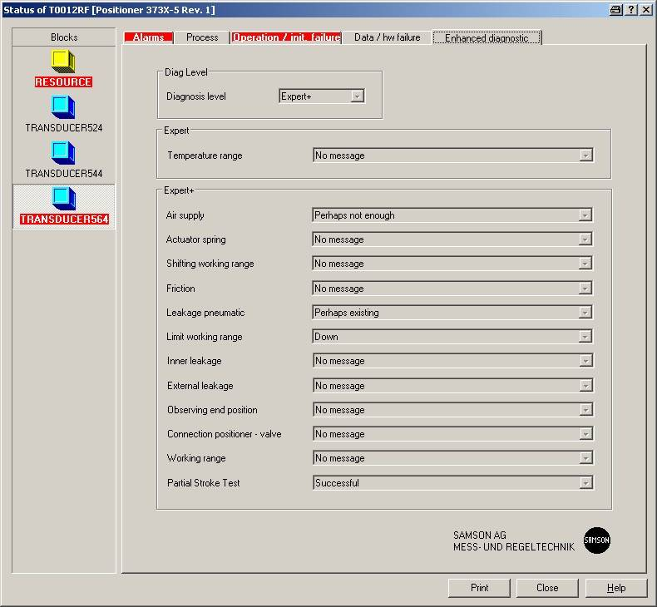
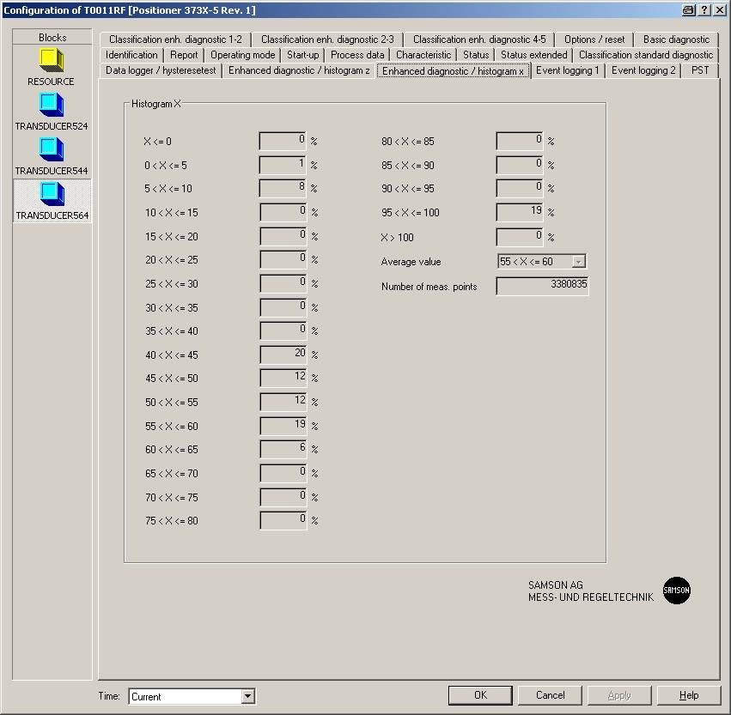
Example – Emerson Delta V/AMS
Positioner type 3730-5 / Rev. 1 – Integration via DD
2014-07/V31 · Configuration Tools · 23

Slide 24
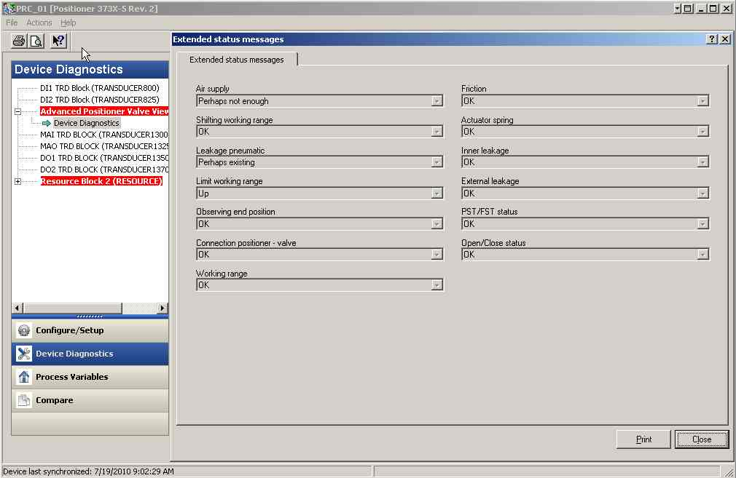
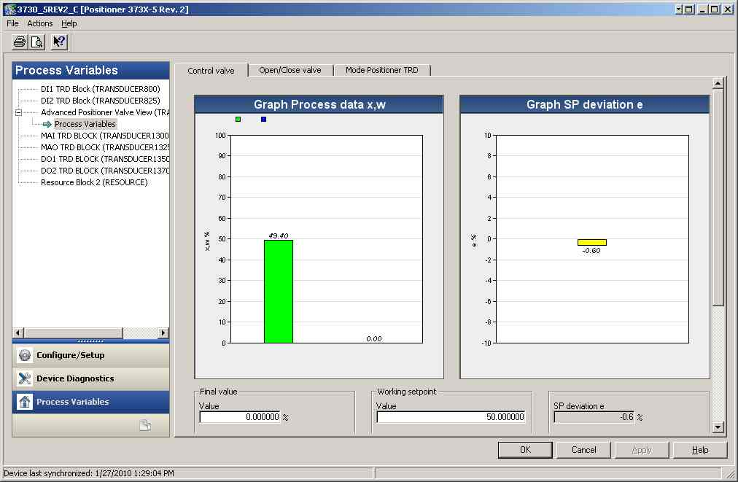
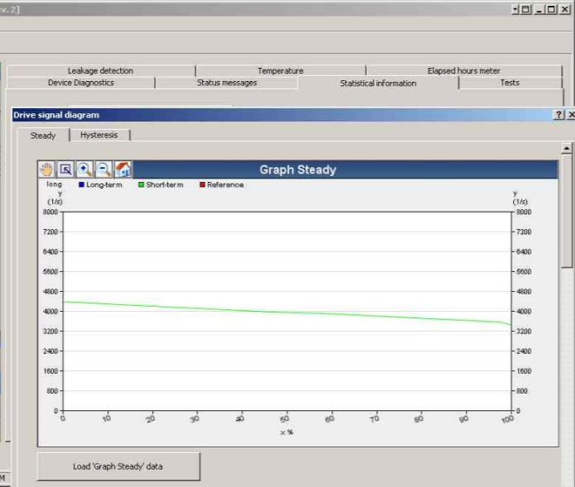
Example – Emerson Delta V/AMS
Positioner type 3730-5 / Rev. 2 – Integration via enhanced EDD
2014-07/V31 · Configuration Tools · 24

Slide 25
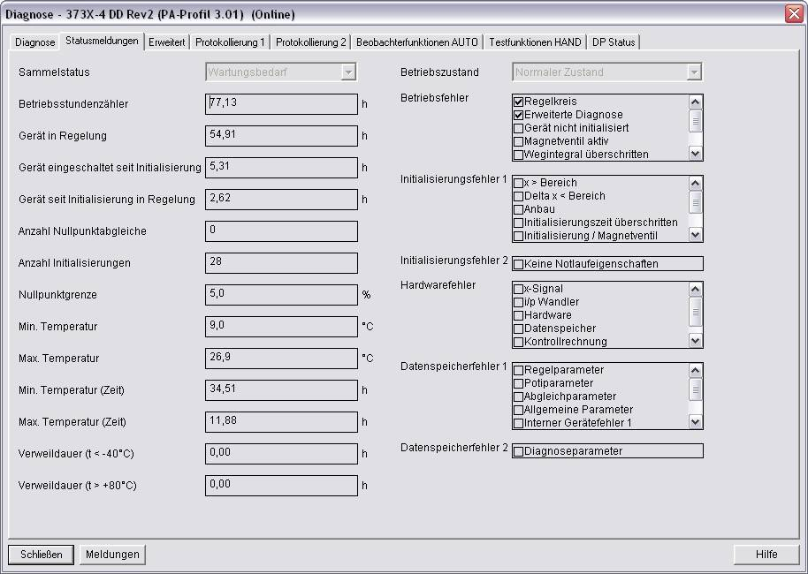
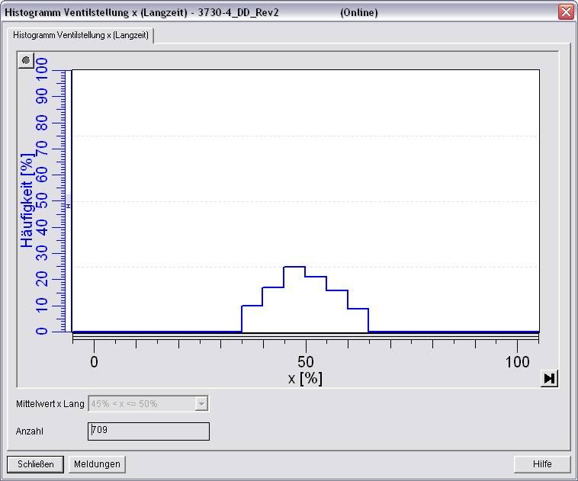
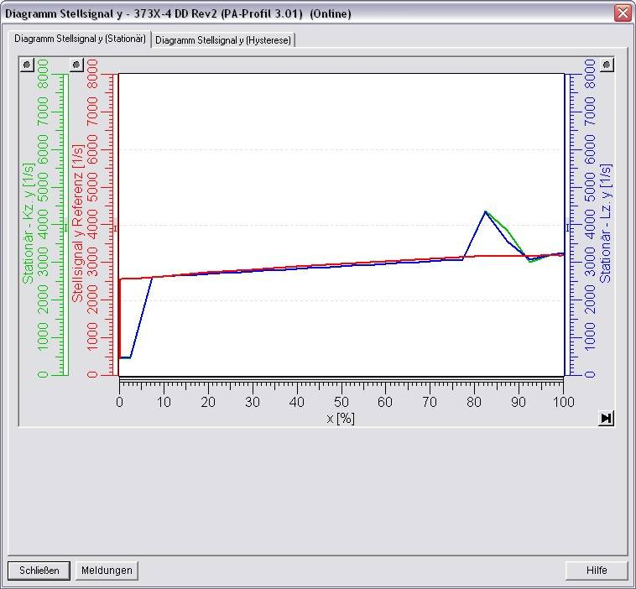
Example – Siemens PDM
Positioner type 3730-4 – Integration via enhanced EDD
2014-07/V31 · Configuration Tools · 25

Slide 26
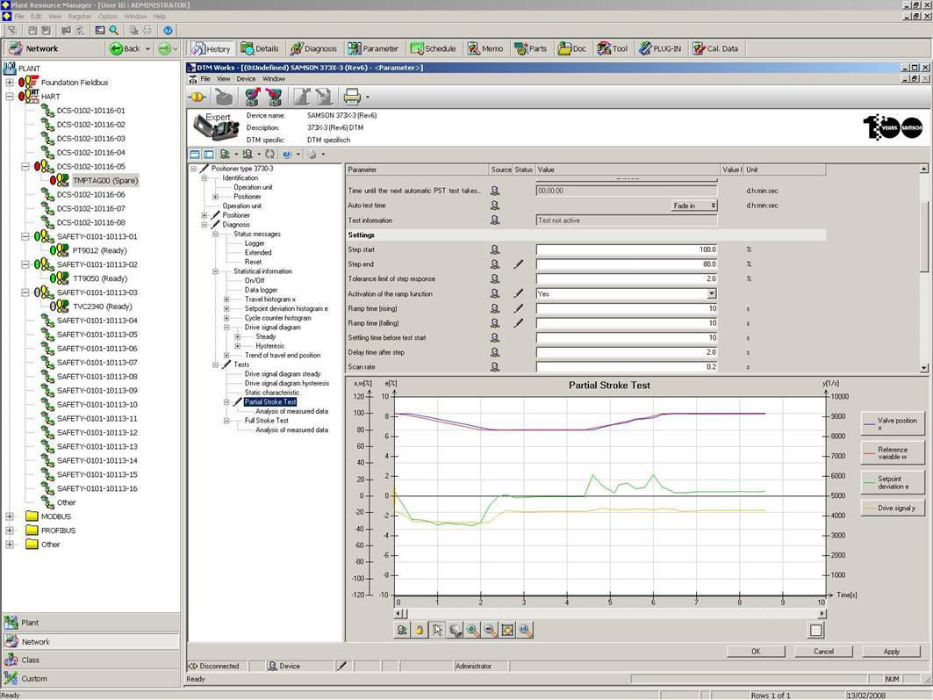
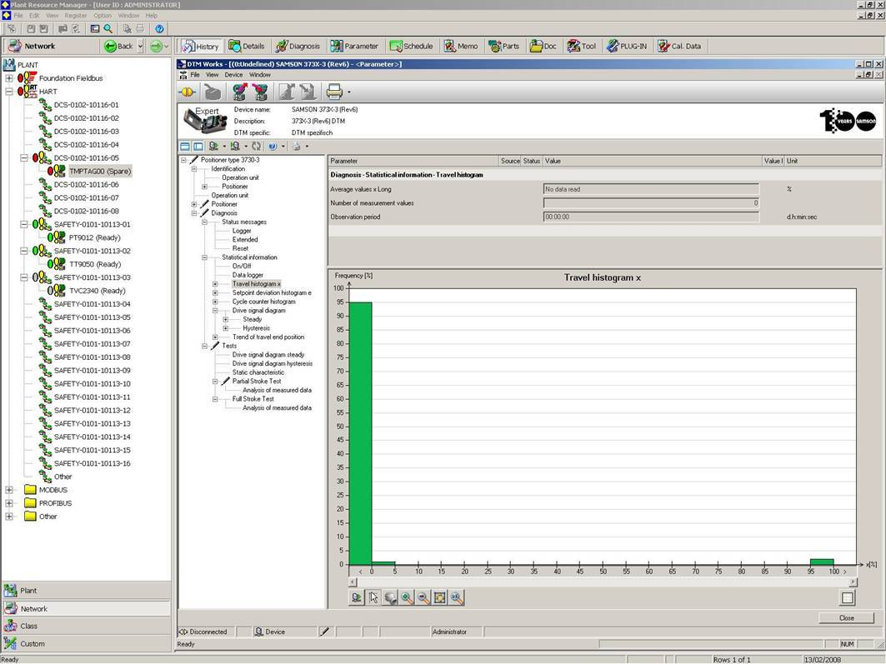
Example – Yokogawa PRM
Positioner type 3730-3 – Integration via DTM
2014-07/V31 · Configuration Tools · 26

